Slide 1
틱택토
(난이도:하)
조창우

Slide 2
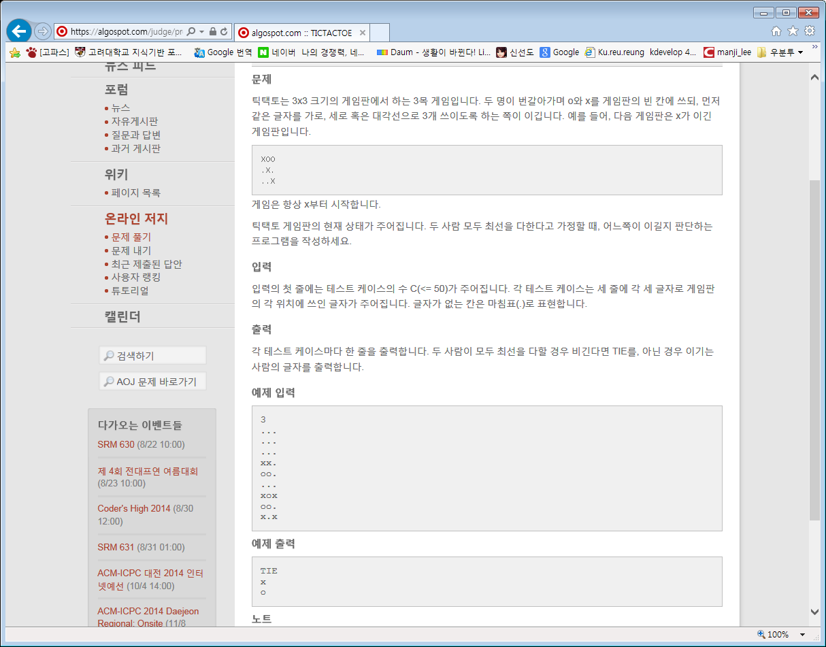

Slide 3
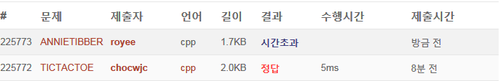

Slide 4
int win=canWin(board, first);
//출력부분
if(win == 1) cout<<first<<endl;
else if(win == -1) cout<<'o'+'x'<<endl;
else cout<<"TIE"<<endl;
cout<<(char)('o'+'x'-first)<<endl;

